Slide 1
CHILDREN
FOURTEENTH EDITION
JOHN W. SANTROCK
Chapter 1
Introduction

Slide 2
Learning Goals
Explain why it is important to research children’s development, and identify five areas in which children’s lives need to be improved
Discuss processes, periods, cohort effects, and issues in development
Summarize why research is important in child development, the main theories of child development, and research methods, designs, and challenges

Slide 3
Why Is Caring for Children Important?
Development: the pattern of change that begins at conception and continues throughout the life span
Importance of studying children’s development
  Becoming a better parent or educator
  Gaining insight into how your childhood experiences have shaped the person you are today

Slide 4
Improving the Lives of Children
In children’s development, important roles are
played by:
  Health and well-being
  Parenting
  Education
  Sociocultural contexts
  Social policy

Slide 5
Sociocultural Contexts and Diversity 1
Dimensions of the sociocultural context—culture, ethnicity, SES, and gender—help to mold how an individual develops through life
Context: the settings, influenced by historical, economic, social, and cultural factors, in which development occurs

Slide 6
Sociocultural Contexts and Diversity 2
Culture: the behavior patterns, beliefs, and all other products of a group that are passed on from generation to generation
  Cross-cultural studies: comparisons of one culture with one or more other cultures
Ethnicity: a characteristic based on cultural heritage, nationality, race, religion, and language

Slide 7
Sociocultural Contexts and Diversity 3
Socioeconomic status (SES): a person’s position within society based on occupational, educational, and economic characteristics
  Socioeconomic status implies certain inequalities
Gender refers to the characteristics of people as males and females

Slide 8
Resilience, Social Policy, and
Children’s Development 1
Some children develop confidence in their abilities despite negative stereotypes about their gender or their ethnic group
Some triumph over poverty or other adversities
These children show resilience

Slide 9
Figure 1 Characteristics of Resilient Children and Their Contexts
Source | Characteristic
Individual | Good intellectual functioning Appealing, sociable, easygoing disposition Self-confidence, high self-esteem Talents Faith
Family | Close Relationship to caring parent figure Authoritative parenting: warmth, structure, high expectations Socioeconomic advantages Connections to extended supportive family networks
Extrafamilial Context | Bonds to caring adults outside the family Connections to positive organizations Attending effective schools

Slide 10
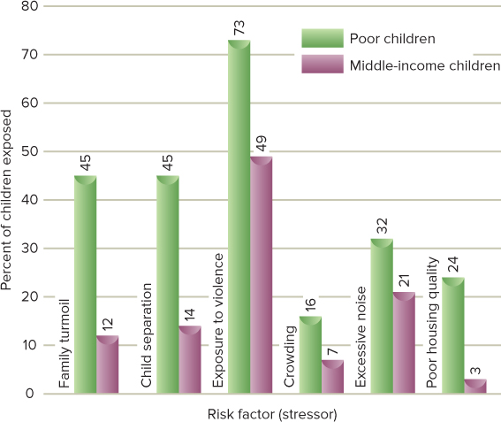
Figure 2 Exposure to Six Stressors Among Poor and Middle-Income Children
One study analyzed the exposure to six stressors among poor children and middle-income children (Evans & English, 2002). Poor children were much more likely to face each of these stressors.
Access the text alternative for the slide image.

Slide 11
Figure 2 Exposure to Six Stressors Among Poor and Middle-Income Children Appendix
The data are represented in a bar graph.
45% of poor children were exposed to family turmoil, compared to 12% of middle-income children.
45% of poor children were exposed to child separation, compared to 14% of middle-income children.
73% of poor children were exposed to violence, compared to 49% of middle-income children.
16% of poor children were exposed to crowding, compared to 7% of middle-income children.
32% of poor children were exposed to excessive noise, compared to 21% of middle-income children.
24% of poor children were exposed to poor housing quality, compared to 3% of middle income children.
Return to previous slide.

Slide 12
Resilience, Social Policy, and
Children’s Development 2
Social policy is a government’s course of action designed to promote the welfare of its citizens
Comprehensive social policies are often created when many are concerned about a social issue
  Child labor laws to protect children
  Federal child-care funding during World War II
  Head Start and other War on Poverty programs

Slide 13
Biological, Cognitive, and
Socioemotional Processes 1
Biological processes produce changes in an individual’s body
Cognitive processes refer to changes in an individual’s thought, intelligence, and language
Socioemotional processes involve changes in an individual’s relations with other people, changes in emotions, and changes in personality

Slide 14
Biological, Cognitive, and
Socioemotional Processes 2
Connection across biological, cognitive, and socioemotional processes is considered in two rapidly emerging fields:
  Developmental cognitive neuroscience
  Developmental social neuroscience
In many instances, biological, cognitive, and socioemotional processes are bidirectional

Slide 15
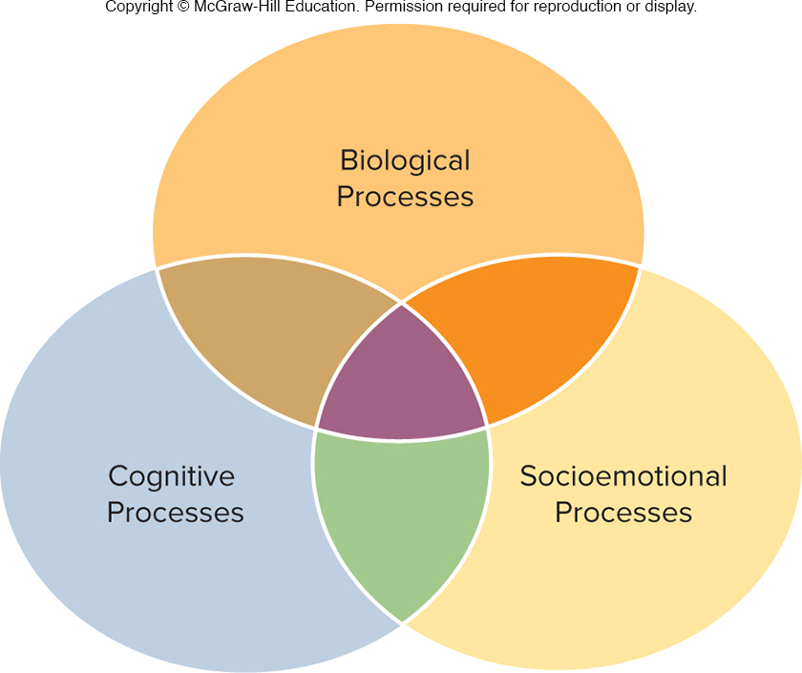
Figure 3 Changes in Development are the Result of Biological, Cognitive, and Socioemotional Processes
Biological, cognitive, and socioemotional processes interact as individuals develop.

Slide 16
Periods of Development 1
Prenatal period is the time from conception to birth
Infancy is the developmental period that extends from birth through 18 to 24 months of age
Early childhood is the developmental period that extends from the end of infancy to about 5 to 6 years of age, sometimes called the preschool years

Slide 17
Periods of Development 2
Middle and late childhood is the developmental period that extends from about 6 to 11 years of age, sometimes called the elementary school years
Adolescence is the developmental period of transition from childhood to early adulthood, entered at approximately 10 to 12 years of age and ending at 18 to 22 years of age

Slide 18
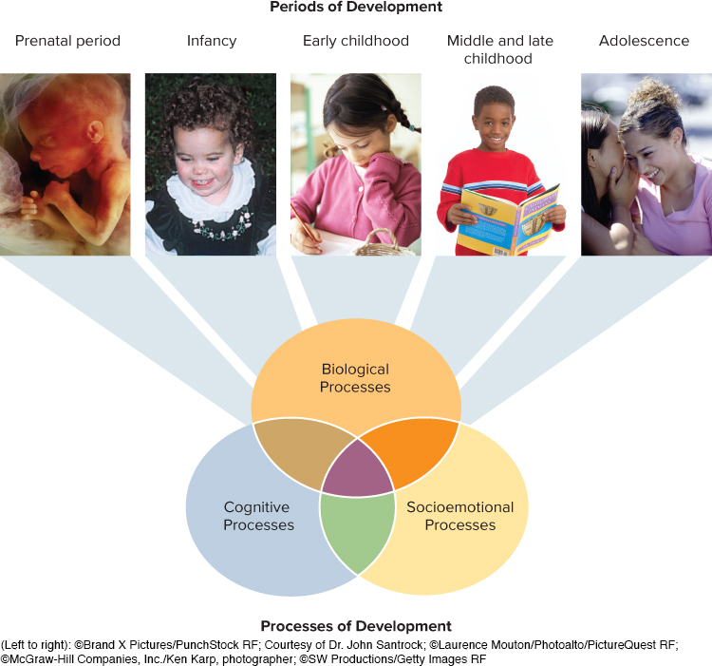
Figure 4 Processes and Periods of Development
Development moves through the prenatal, infancy, early childhood, middle and late childhood, and adolescence periods. These periods of development are the result of biological, cognitive, and socioemotional processes.
(Left to right): ©Brand X Pictures/PunchStock RF; Courtesy of Dr. John Santrock; ©Laurence Mouton/Photoalto/PictureQuest RF; ©McGraw-Hill Companies, Inc./Ken Karp, photographer; ©SW Productions/Getty Images RF

Slide 19
Age and Cohort Effects
Cohort effects: effects due to a person’s time of birth, era, and generation but not to actual age
Millennials: the generation born after 1980 that is the first to come of age and enter emerging adulthood in the new millennium
  Two characteristics: their ethnic diversity and their connection to technology

Slide 20
Issues in Development 1
Nature and nurture issue: the issue regarding whether development is primarily influenced by nature or nurture
Continuity and discontinuity issue: the issue regarding whether development involves gradual, cumulative change (continuity) or distinct stages (discontinuity)
Early and later experience issue: the issue of the degree to which early experiences or later experiences are the key determinants of the child’s development

Slide 21
Issues in Development 2
Evaluating developmental issues
  Nature and nurture, continuity and discontinuity, and early and late experiences all play a part in development
  Spirited debate regarding the strength of each influence continues among researchers

Slide 22
The Importance of Research 1
Scientific research is objective, systematic, and testable
It reduces the likelihood that information will be based on personal beliefs, opinions, and feelings

Slide 23
The Importance of Research 2
Scientific research is based on the scientific method
Scientific method: an approach that can be used to obtain accurate information
  Conceptualize the problem
  Collect data
  Draw conclusions
  Revise research conclusions and theory

Slide 24
The Importance of Research 3
Theory: an interrelated, coherent set of ideas that helps to explain and make predictions
Hypothesis: a specific assumption or prediction that can be tested to determine its accuracy

Slide 25
Theories of Child Development: Psychoanalytic Theories
Psychoanalytic theories: theories describing development as primarily unconscious and heavily colored by emotion
  Behavior is merely a surface characteristic
  Symbolic workings of the mind have to be analyzed to understand behavior
  Early experiences with parents are emphasized

Slide 26
Figure 6 Freudian Stages
Oral Stage | Anal Stage | Phallic Stage | Latency Stage | Genital Stage
Infant’s pleasure centers on the mouth. | Child’s pleasure focuses on the anus. | Child’s pleasure focuses on the genitals. | Child represses sexual interest and develops social and intellectual skills. | A time of sexual reawakening; source of sexual pleasure becomes someone outside the family.
Birth to 1½ Years | 1½ to 3 Years | 3 to 6 Years | 6 Years to Puberty | Puberty Onward
Because Freud emphasized sexual motivation, his stages of development are known as psychosexual stages. In his view, if the need for pleasure at any stage is either undergratified or overgratified, an individual may become fixated, or locked in, at that stage of development.

Slide 27
Figure 7
Erikson’s Eight Life-Span Stages
Erikson’s Stages | Developmental Period
Integrity versus despair | Late adulthood (60s onward)
Generativity versus stagnation | Middle adulthood (40s, 50s)
Intimacy versus isolation | Early adulthood (20s, 30s)
Identity versus identity confusion | Adolescence (10 to 20 years)
Industry versus inferiority | Middle and late childhood (elementary school years, 6 years to puberty)
Initiative versus guilt | Early childhood (preschool years, 3 to 5 years)
Autonomy versus shame and doubt | Infancy (1 to 3 years)
Trust versus mistrust | Infancy (first year)
Like Freud, Erikson proposed that individuals go through distinct, universal stages of development.

Slide 28
Evaluating the Psychoanalytic Theories 1
Contributions of psychoanalytic theories:
  Early experiences play an important part in development
  Family relationships are a central aspect of development
  Personality can be better understood if it is examined developmentally
  Activities of the mind are not entirely conscious—unconscious aspects need to be considered
  In Erikson’s theory, changes take place in adulthood as well as in childhood

Slide 29
Evaluating the Psychoanalytic Theories 2
Criticisms:
  Main concepts are difficult to test scientifically
  Much of the data used to support these theories come from individuals’ reconstruction of the past and are of unknown accuracy
  Sexual underpinnings of development are given too much importance
  Unconscious mind is given too much credit for influencing development
  Psychoanalytic theories present an image of humans that is too negative and are culture- and gender-biased

Slide 30
Theories of Child Development: Cognitive Theories
Cognitive theories emphasize conscious thoughts
Piaget’s theory: children actively construct their understanding of the world and go through four stages of cognitive development

Slide 31

Figure 8 Piaget’s Four Stages of Cognitive Development
Sensorimotor Stage | Preoperational Stage | Concrete Operational Stage | Formal Operational Stage
The infant constructs an understanding of the world by coordinating sensory experiences with physical actions. An infant progresses from reflexive, instinctual action at birth to the beginning of symbolic thought toward the end of the stage. | The child begins to represent the world with words and images. These words and images reflect increased symbolic thinking and go beyond the connection of sensory information and physical action. | The child can now reason logically about concrete events and classify objects into different sets. | The adolescent reasons in more abstract, idealistic, and logical ways.
Birth to 2 Years of Age | 2 to 7 Years of Age | 7 to 11 Years of Age | 11 Years of Age Through Adulthood
According to Piaget, how a child thinks—not how much the child knows—determines the child’s stage of cognitive development.
(Left to right): © Stockbyte/Getty Images RF; © BananaStock/PunchStock RF; © image100/Corbis RF; © Purestock/Getty Images RF

Slide 32
Cognitive Theories
Vygotsky’s theory: a sociocultural cognitive theory that emphasizes how culture and social interaction guide cognitive development
Information-processing theory: emphasizes that individuals manipulate information, monitor it, and strategize about it
  Central to this theory are the processes of memory and thinking
  Microgenetic method seeks to discover not just what the child knows but the cognitive processes involved in knowledge acquisition

Slide 33
Evaluating the Cognitive Theories 1
Primary contributions of cognitive theories:
  Present a positive view of development, emphasizing conscious thinking
  Emphasize the individual’s active construction of understanding
  Piaget’s and Vygotsky’s theories underscore the importance of examining developmental changes in children’s thinking
  Information-processing theory offers detailed descriptions of cognitive processes

Slide 34
Evaluating the Cognitive Theories 2
Criticisms:
  Piaget’s stages are not as uniform as he theorized
  Cognitive theories do not give adequate attention to individual variations in cognitive development
  Information-processing theory does not provide an adequate description of developmental changes in cognition
  Psychoanalytic theorists argue that the cognitive theories do not give enough credit to unconscious thought

Slide 35
Theories of Child Development:
Behavioral and Social Cognitive Theories
Pavlov’s classical conditioning
  Neutral stimulus acquires the ability to produce a response originally produced by another stimulus
Skinner’s operant conditioning
  Consequences of a behavior produce changes in the probability of the behavior’s occurrence
  Behavior followed by a rewarding stimulus is more likely to recur
  Behavior followed by a punishing stimulus is less likely to recur

Slide 36
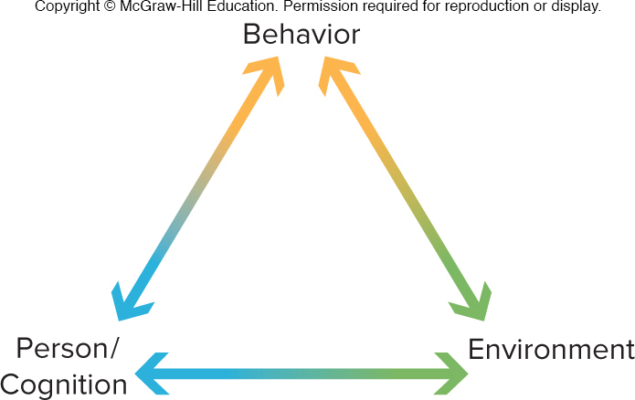
Figure 9 Bandura’s Social Cognitive Model
The arrows illustrate how relations between behavior, person/cognition, and environment are reciprocal rather than one-way. Person/cognition refers to cognitive processes (for example, thinking and planning) and personal characteristics (for example, believing that you can control your experiences).

Slide 37
Evaluating the Behavioral and Social Cognitive Theories 1
Contributions of the behavioral and social cognitive theories:
  Emphasis on the importance of scientific research
  Focus on environmental determinants of behavior
  Identification and explanation of observational learning
  Inclusion of person/cognitive factors

Slide 38
Evaluating the Behavioral and Social Cognitive Theories 2
Criticisms:
  Too little emphasis on cognition
  Too much emphasis on environmental determinants
  Inadequate attention given to developmental changes
  Inadequate recognition of human spontaneity and creativity

Slide 39
Theories of Child Development: Ethological and Ecological Theories
Ethology stresses that behavior is strongly influenced by biology, is tied to evolution, and is characterized by critical or sensitive periods
Ecological theory emphasizes environmental factors
Bronfenbrenner’s ecological theory is an environmental systems theory that focuses on five environmental systems

Slide 40
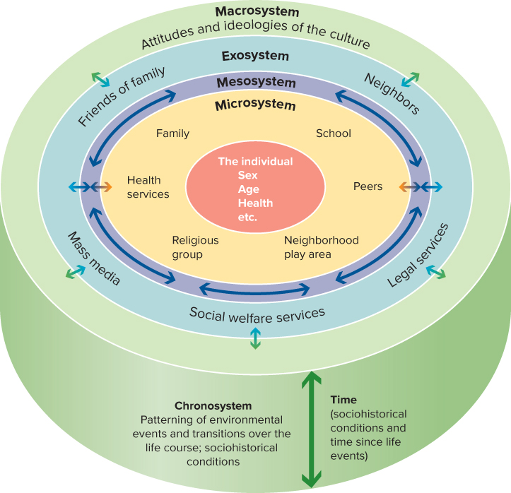
Figure 10 Bronfenbrenner’s Ecological Theory of Development
Bronfenbrenner’s ecological theory consists of five environmental systems: microsystem, mesosystem, exosystem, macrosystem, and chronosystem.
Access the text alternative for the slide image.

Slide 41
Figure 12 A Comparison of Theories and Issues in Child Development
Theory | Issue: Nature and nurture | Issue: Early and later experience | Issue: Continuity and discontinuity
Psychoanalytic | Freud’s biological determinism interacting with early family experiences; Erikson’s more balanced biological/cultural interaction perspective | Early experiences in the family very important influences | Emphasis on discontinuity between stages
Cognitive | Piaget’s emphasis on interaction and adaptation; environment provides the setting for cognitive structures to develop. Vygotsky’s theory involves interaction of nature and nurture with strong emphasis on culture. The information-processing approach has not addressed this issue extensively; mainly emphasizes biological/environment interaction. | Childhood experiences important influences | Discontinuity between stages in Piaget’s theory; no stages in Vygotsky’s theory or the information-processing approach
Behavioral and Social Cognitive | Environment viewed as the main influence on development | Experiences important at all points in development | Continuity with no stages
Ethological | Strong biological view | Early experience very important, which can contribute to change early in development; after early critical or sensitive period has passed, stability likely to occur | Discontinuity because of early critical or sensitive period; no stages
Ecological | Strong environmental view | Experiences involving the five environmental systems important at all points in development | No stages but little attention to the issue

Slide 42
An Eclectic Theoretical Orientation
These theories are helpful guides, but reliance on a single theory is problematic
Eclectic theoretical orientation does not follow any one theoretical approach but rather selects from each theory whatever is considered its best features

Slide 43
Research Methods for Collecting Data:
Observation
To be effective, observations must be systematic
Where should observations be made?
  Laboratory: a controlled setting in which many of the complex factors of the “real world” are removed
  Naturalistic observation: behavior is observed in real-world settings

Slide 44
Other Research Methods
Survey (a questionnaire) and interview
Standardized test: uniform procedures for administration and scoring
Case study: in-depth look at a single individual
Physiological measures, which include hormone levels, neuroimaging, heart rate, and eye movements

Slide 45
Research Designs 1
Descriptive research: a research design that has the purpose of observing and recording behavior
Correlational research: a research design whose goal is to describe the strength of the relationship between two or more events or characteristics
  Correlation coefficient: a number based on statistical analysis that is used to describe the degree of association between two variables

Slide 46
Research Designs 2
Experiment: a carefully regulated procedure in which one or more of the factors believed to influence the behavior being studied are manipulated, while all other factors are held constant
  Consists of independent (manipulated) and dependent (measured) variables
  Experimental group: the group’s experience is manipulated
  Control group: a comparison group treated the same way except for the manipulated factor
  Random assignment: participants are assigned to the experimental and control groups by chance

Slide 47
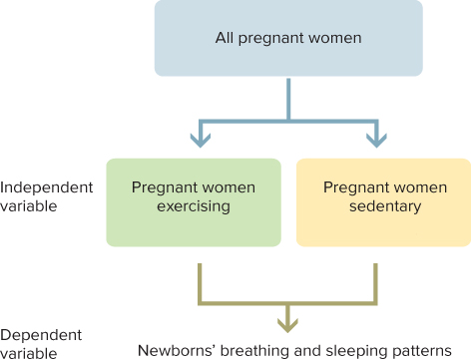
Figure 16 Principles of Experimental Research
Imagine that you decide to conduct an experimental study of the effects of aerobic exercise by pregnant women on their newborns’ breathing and sleeping patterns. You would randomly assign pregnant women to experimental and control groups. The experimental-group women would engage in aerobic exercise over a specified number of sessions and weeks. The control group would not. Then, when the infants are born, you would assess their breathing and sleeping patterns. If the breathing and sleeping patterns of newborns whose mothers were in the experimental group are more positive than those of the control group, you would conclude that aerobic exercise caused the positive effects.

Slide 48
Time Span of Research
Cross-sectional approach: a research strategy in which individuals of different ages are compared at one time
Longitudinal approach: a research strategy in which the same individuals are studied over a period of time, usually several years or more

Slide 49
Research Challenges
Conducting ethical research
  Protect the rights of research subjects
  Do not cause any harm
  Adhere to a code of ethics
APA’s guidelines
  Informed consent
  Confidentiality
  Debriefing
  Deception

Slide 50
Minimizing Bias
Gender bias consists of preconceived ideas about female and male abilities that prevent individuals from pursuing their own interests and potential
  Research reports sometimes magnify any differences observed
Cultural and ethnic bias has led to excluding minorities and considering them as variations from the “norm”
Ethnic gloss: the use of an ethnic label in a superficial way that portrays an ethnic group as more homogeneous than it really is

Slide 51
Review
Explain why it is important to research children’s development, and identify five areas in which children’s lives need to be improved
Discuss processes, periods, cohort effects, and issues in development
Summarize why research is important in child development, the main theories of child development, and research methods, designs, and challenges

Slide 52
Appendix A
Text alternatives for slide images

Slide 53
Figure 10 Bronfenbrenner’s Ecological Theory of Development Appendix
The center of the model is the individual’s characteristics: sex, age, health, etc.
The most immediate environmental system, imagined as a ring around the individual, is the microsystem: family, school, peers, neighborhood play area, church group, health services.
Between the microsystem ring and the exosystem ring is the mesosystem.
The exosystem ring consists of friends of family, neighbors, legal services, social welfare services, and mass media.
Surrounding all of these is the macrosystem ring, consisting of the attitudes and ideologies of the culture.
Finally the chronosystem, time, is imagined as depth in the system of rings, symbolizing sociohistorical conditions and time since life events.
Return to previous slide.

